Slide 1
Combined loading cases

Slide 2
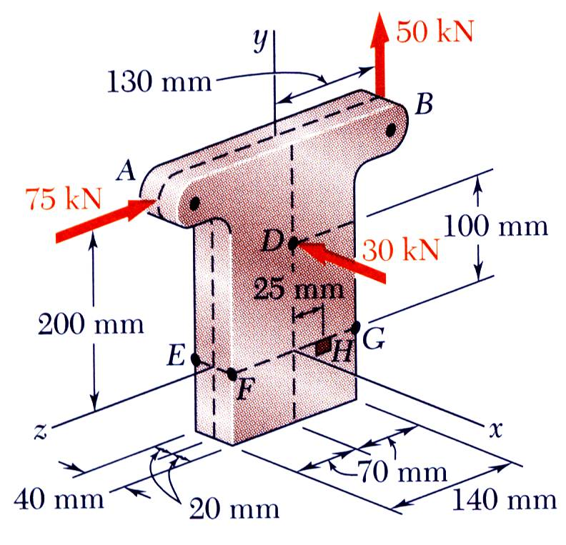
Three forces are applied to a short steel post as shown. Determine the principle stresses, principal planes and maximum shearing stress at point H.

Slide 3
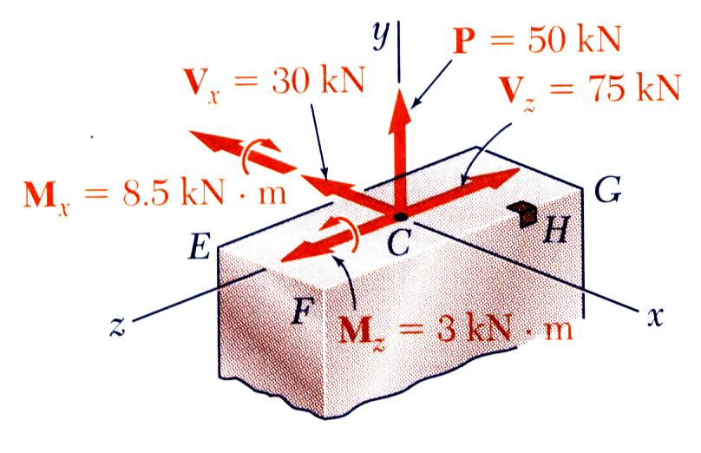
SOLUTION:
Determine internal forces in Section EFG.
Note: Section properties,

Slide 4
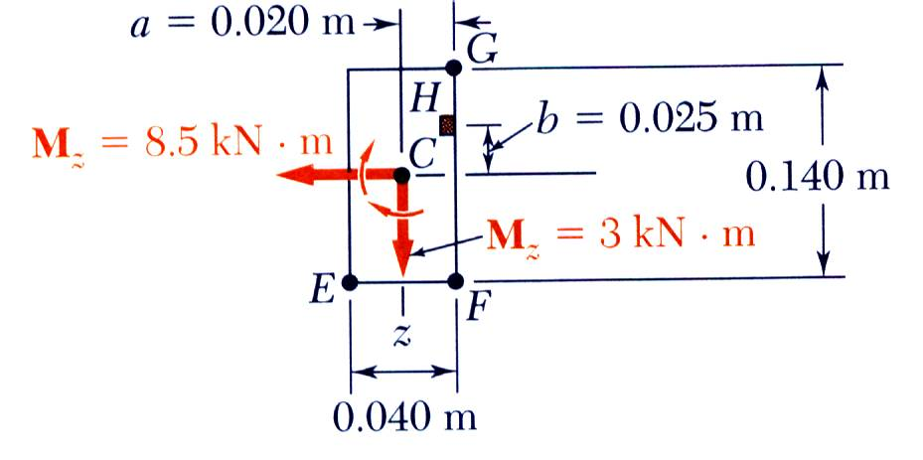
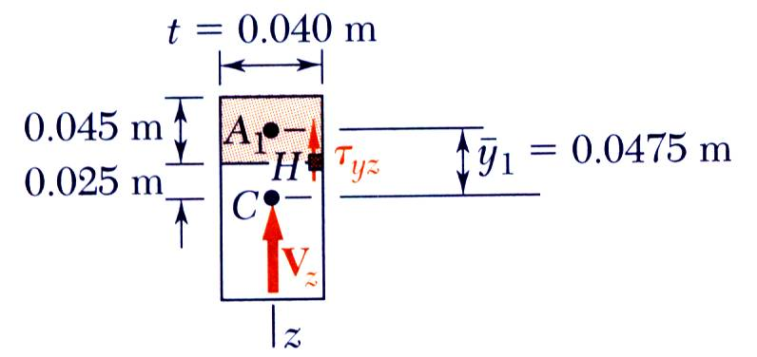
Evaluate normal stress at H.
Evaluate shearing stress at H.

